Slide 1


Market Trends in Building Envelope Coatings
Eric O’Bryan
BASF Construction Solutions Dispersions and Resins
Building Envelope Market Segment Manager
eric.obryan@basf.com
FPCA 2023

Slide 2

Market Trends
Labor Shortage / Cost Increase
Energy Efficiency Increase Customer Consolidation
New Systems and Business Models
Sustainability

Slide 3
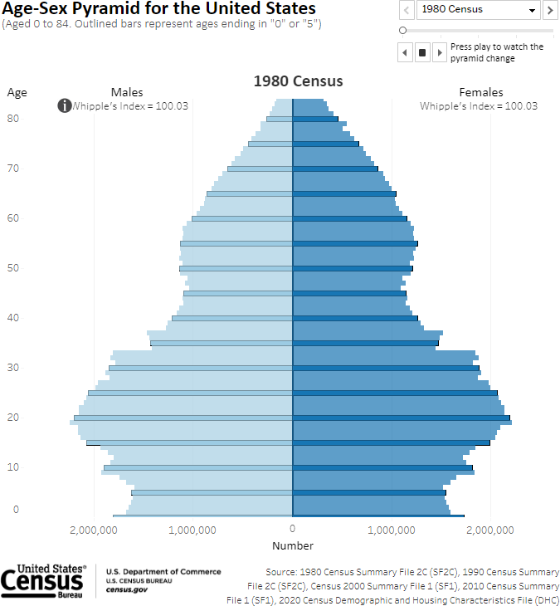
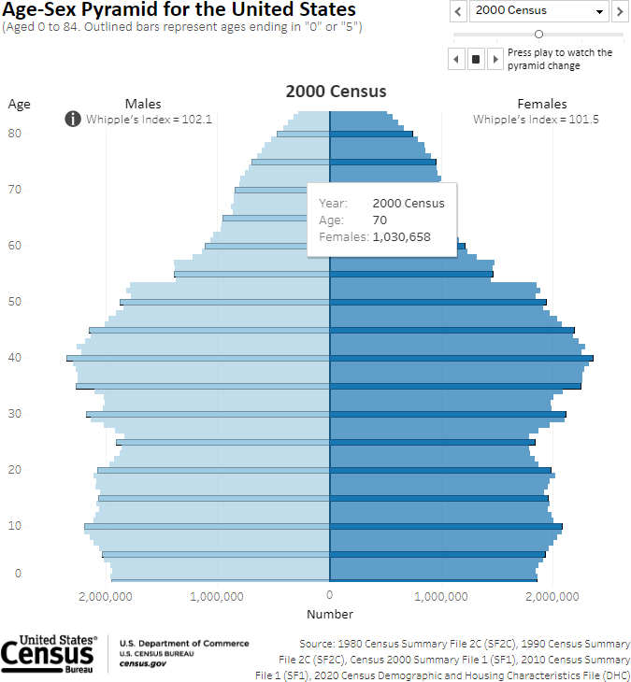
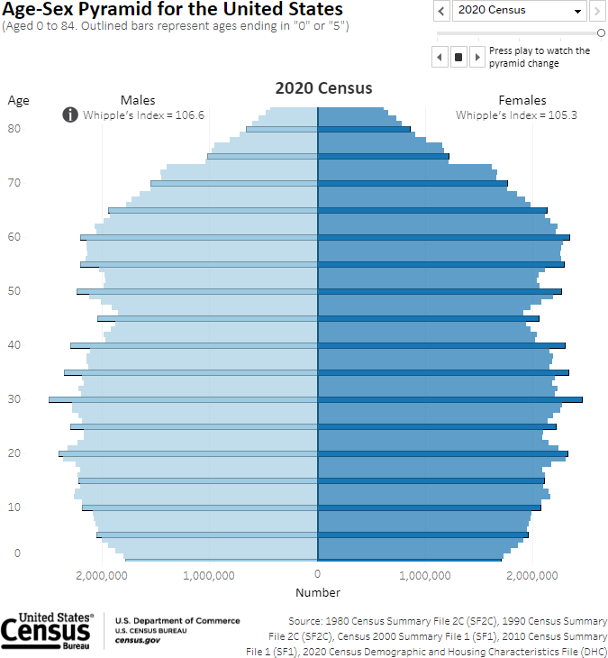
Labor Shortage

Slide 4
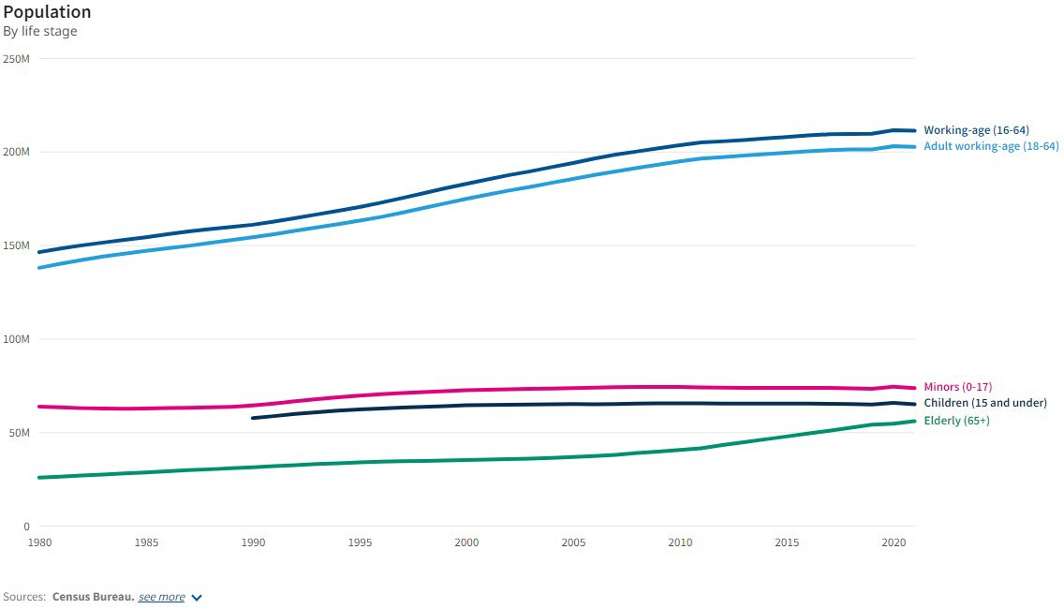
Labor Shortage

Slide 5
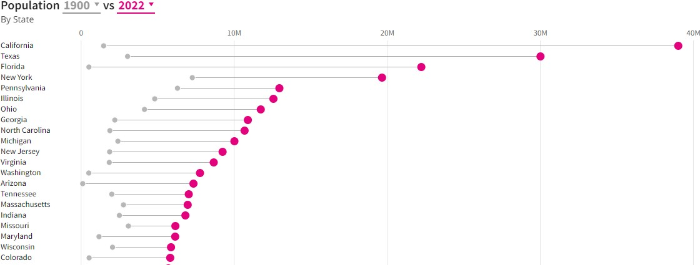

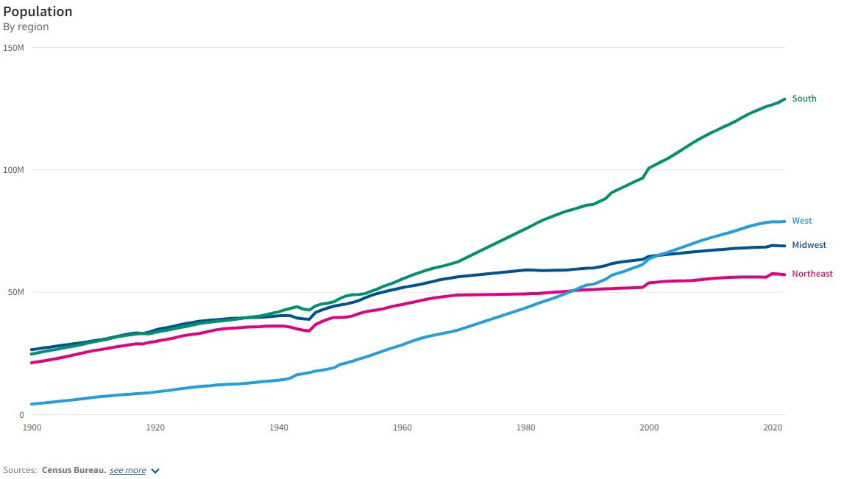
Labor Shortage
U.S. Census Bureau

Slide 6

Labor Shortage – Implication on Coatings
One coat
Faster dry / set time
Broader application environments: cold, wet, humid

Slide 7

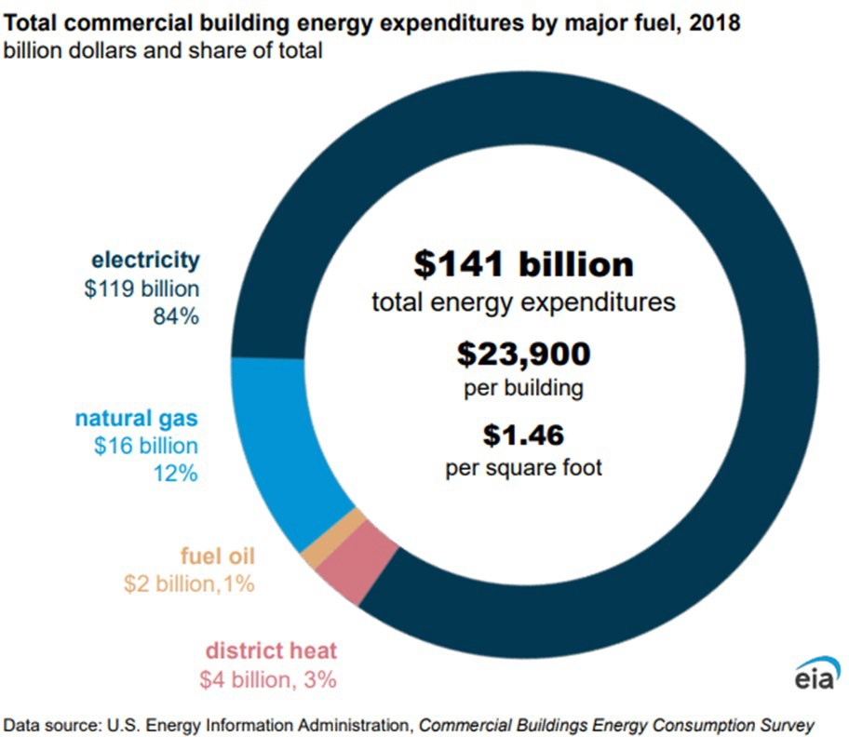
Energy Efficiency

Slide 8
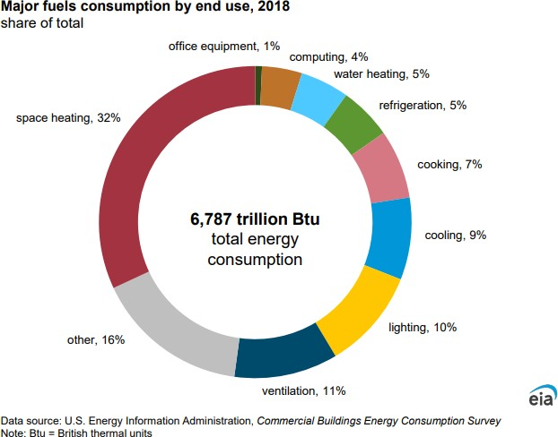
Energy Efficiency

Slide 9
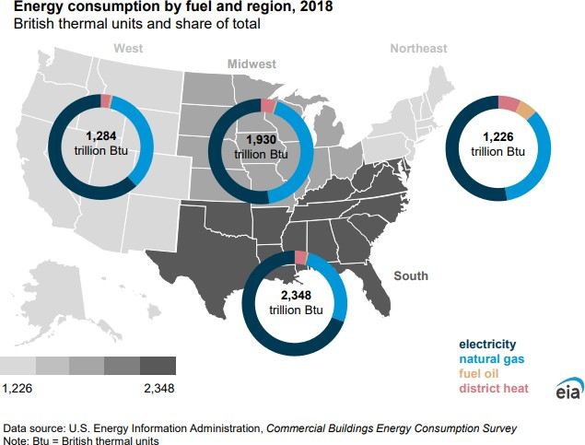
Energy Efficiency

Slide 10
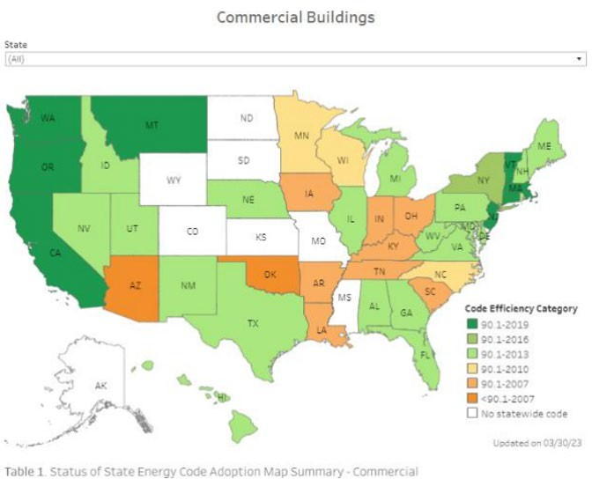
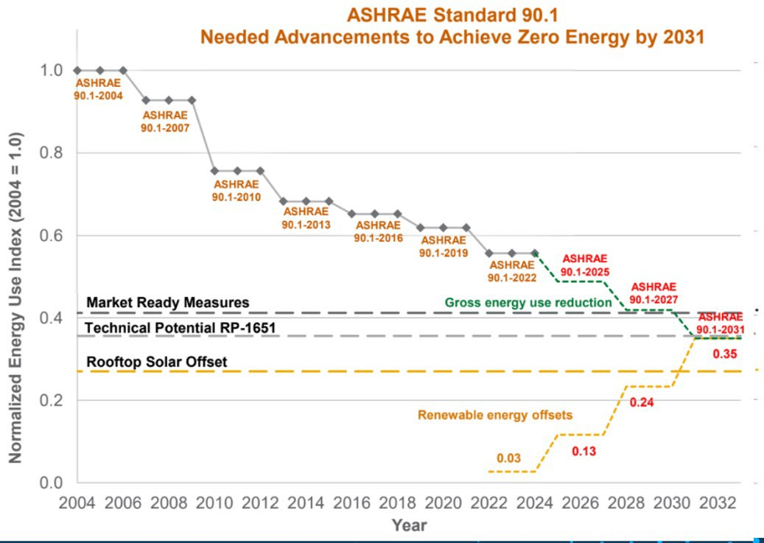
Energy Efficiency

Slide 11
Energy Efficiency -- Implication on Coatings
Initial Performance
 High reflectivity
 Seal holes
Long Term Performance
 Products must maintain performance:
  Dirt pick-up resistance
  Elongation to maintain seal

Slide 12

Customer Consolidation

Slide 13

Customer Consolidation – Implication on Coatings
Increased buying power - good cost performance alternatives
Big budgets for deep innovation and new step change solutions

Slide 14

New Systems
Prefabrication
System / layer consolidation
New substrates

Slide 15

New Systems – Implications on Coatings
Customers consider total cost of ownership – looking for solutions not products
System cost not product cost is evaluated: combine layers, integrate systems, prefab vs. on- site

Slide 16


Sustainability
Recycled feedstock
Renewable feedstock
derived from plastic waste
derived from organic waste

Slide 17

Sustainability – Implication on Coatings
Product Carbon Footprint
Chemicals of Concern

Slide 18


Let’s talk about your needs in construction.
Eric O’Bryan
BASF Construction Solutions Dispersions and Resins
Building Envelope Market Segment Manager eric.obryan@basf.com
1

Slide 19
Disclaimer
While the descriptions, designs, data and information contained herein are presented in good faith and believed to be accurate, they are provided for guidance only. Because many factors may affect processing or application/use, BASF recommends that the reader make tests to determine the suitability of a product for a particular purpose prior to use. NO WARRANTIES OF ANY KIND, EITHER EXPRESSED OR IMPLIED, INCLUDING, BUT NOT LIMITED TO, WARRANTIES OF MERCHANTABILITY OR FITNESS FOR A PARTICULAR PURPOSE, ARE MADE REGARDING PRODUCTS DESCRIBED OR DESIGNS, DATA OR INFORMATION SET FORTH, OR THAT THE PRODUCTS, DESCRIPTIONS, DESIGNS, DATA OR INFORMATION MAY BE USED WITHOUT INFRINGING THE INTELLECTUAL PROPERTY RIGHTS OF
OTHERS. In no case shall the descriptions, information, data or designs provided be considered a part of BASF's terms and conditions of sale. Further, the descriptions, designs, data, and information furnished by BASF hereunder are given gratis and BASF assumes no obligation or liability for the descriptions, designs, data or information given or results obtained all such being given and accepted at the reader's risk. (2023)
© BASF Corporation, 2023
19

